Slide 1
Bayesian Network
Session 10
Henry Lucky, S.Kom., M.Kom.

Slide 2
Learning Outcomes
Session 10
At the end of this session, students will be able to:
LO 4: Apply various techniques to an agent when acting under uncertainty

Slide 3
outline
Session 10
Strict and Conditional Independence
Bayesian Network
Bayesian Network Syntax and Semantics
Causality in Bayesian Network

Slide 4
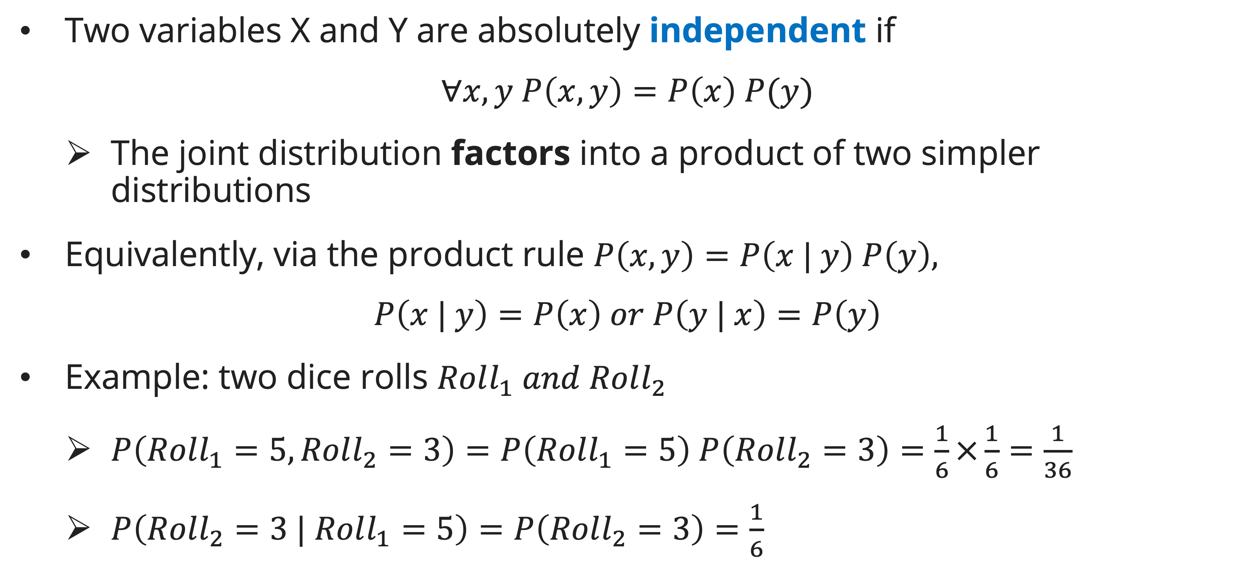
Strict and conditional independence
Strict independence
Two variables X and Y are absolutely independent if
$$∀x, y P\left(x, y\right)=P\left(x\right) P(y)$$
  The joint distribution factors into a product of two simpler distributions
Equivalently, via the product rule $P\left(x, y\right)=P\left(x | y\right) P\left(y\right),$
$$P\left(x | y\right)=P\left(x\right) or P\left(y | x\right)=P\left(y\right)$$
Example: two dice rolls $Roll_{1} and Roll_{2}$
  $P\left(Roll_{1}=5, Roll_{2}=3\right)=P\left(Roll_{1}=5\right) P\left(Roll_{2}=3\right)=\frac{1}{6}×\frac{1}{6}=\frac{1}{36}$
  $P\left(Roll_{2}=3 | Roll_{1}=5\right)=P\left(Roll_{2}=3\right)=\frac{1}{6}$

Slide 5
Strict and conditional independence
Strict independence
Another example of strict independence: Coin Flip
  Doesn’t matter how many times you flip a coin; the probabilities are independent of each other.
What about other case?
  Probability of Rain, Traffic, and bringing Umbrella

Slide 6
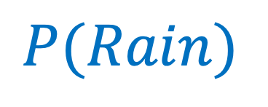

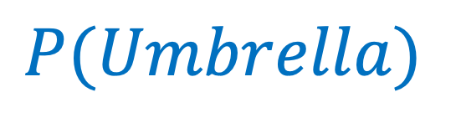
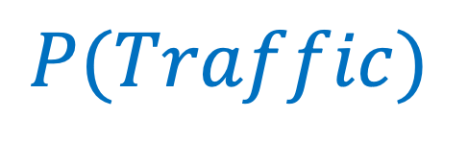
Strict and conditional independence
Strict independence
Given these probabilities:
Can we calculate the full joint distributions $P(Rain, Traffic, Umbrella)$ independently?
  $P(Rain)∗P(Traffic)∗P(Umbrella)$
$$P(Rain)$$
$$P(Traffic)$$
$$P(Umbrella)$$
F | T
0.7 | 0.3
F | T
0.65 | 0.35
F | T
0.69 | 0.31

Slide 7
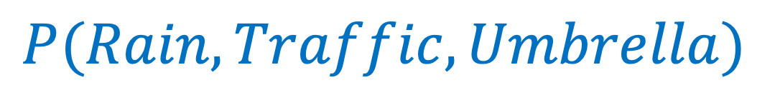
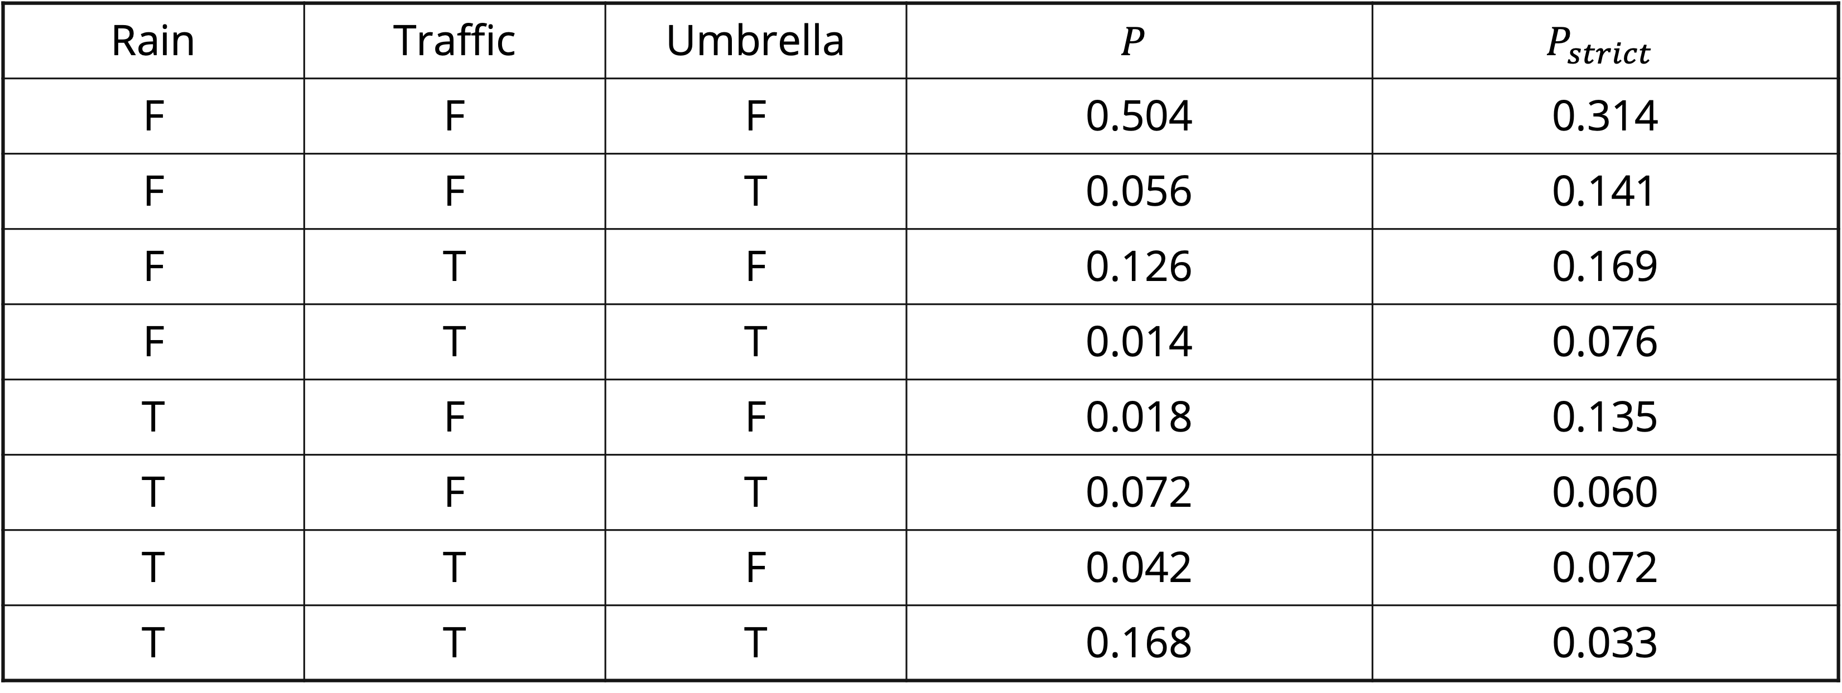
Strict and conditional independence
Strict independence
$$P(Rain, Traffic, Umbrella)$$
Rain | Traffic | Umbrella | $$P$$ | $$P_{strict}$$
F | F | F | 0.504 | 0.314
F | F | T | 0.056 | 0.141
F | T | F | 0.126 | 0.169
F | T | T | 0.014 | 0.076
T | F | F | 0.018 | 0.135
T | F | T | 0.072 | 0.060
T | T | F | 0.042 | 0.072
T | T | T | 0.168 | 0.033
❌
Not equal to the actual probability = Not strict

Slide 8
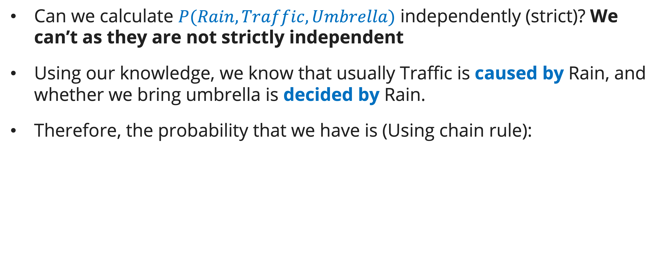
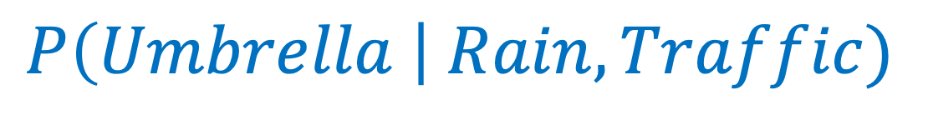
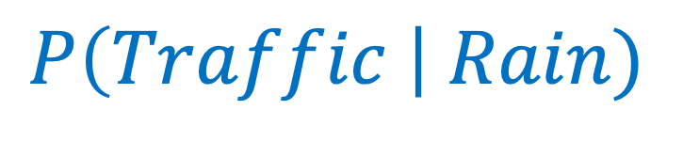
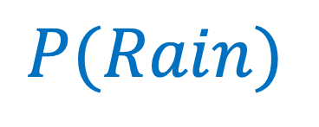
Strict and conditional independence
CONDITIONAL independence
Can we calculate $P(Rain, Traffic, Umbrella)$ independently (strict)? We can’t as they are not strictly independent
Using our knowledge, we know that usually Traffic is caused by Rain, and whether we bring umbrella is decided by Rain.
Therefore, the probability that we have is (Using chain rule):
$$P(Rain)$$
$$P\left(Traffic \right| Rain)$$
$$P\left(Umbrella \right| Rain, Traffic)$$
F | T
0.7 | 0.3
 | Traffic
Rain | F | T
F | 0.8 | 0.2
T | 0.3 | 0.7
 |  | Umbrella
Rain | Traffic | F | T
F | F | 0.9 | 0.1
F | T | 0.9 | 0.1
T | F | 0.2 | 0.8
T | T | 0.2 | 0.8

Slide 9
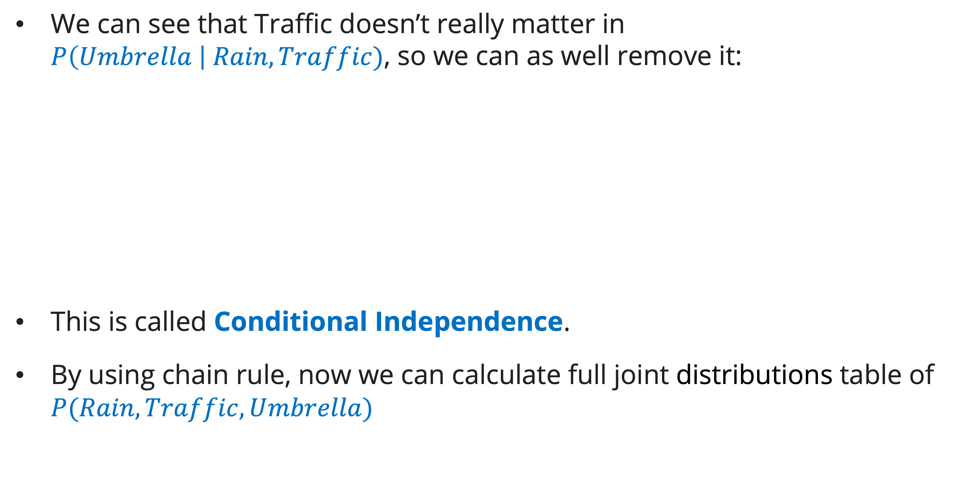
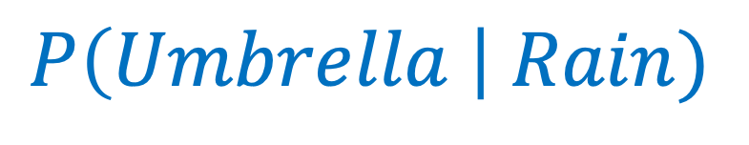
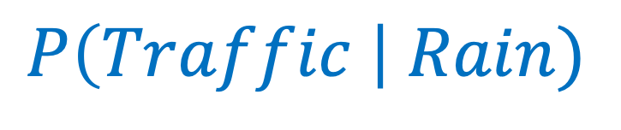
Strict and conditional independence
CONDITIONAL independence
We can see that Traffic doesn’t really matter in $P\left(Umbrella \right| Rain, Traffic)$, so we can as well remove it:
This is called Conditional Independence.
By using chain rule, now we can calculate full joint distributions table of $P(Rain, Traffic, Umbrella)$
$$P(Rain)$$
$$P\left(Traffic \right| Rain)$$
$$P\left(Umbrella \right| Rain)$$
F | T
0.7 | 0.3
 | Traffic
Rain | F | T
F | 0.8 | 0.2
T | 0.3 | 0.7
 | Umbrella
Rain | F | T
F | 0.9 | 0.1
T | 0.2 | 0.8

Slide 10

Strict and conditional independence
CONDITIONAL independence
Example of Chain Rule:
  $P\left(¬rain,¬traffic,¬umbrella\right)$
  $=P\left(¬rain\right)∗P\left(¬traffic | ¬rain\right)∗P\left(¬umbrella \right|¬rain)$
  $=0.7∗0.8∗0.9=0.504$

Slide 11
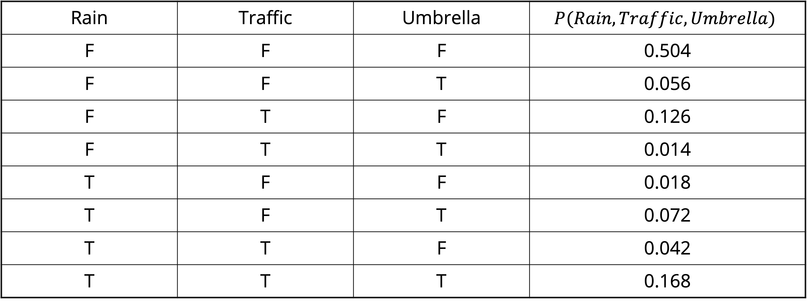
Strict and conditional independence
conditional independence
$$P(Rain, Traffic, Umbrella)$$
Rain | Traffic | Umbrella | $$P(Rain, Traffic, Umbrella)$$
F | F | F | 0.504
F | F | T | 0.056
F | T | F | 0.126
F | T | T | 0.014
T | F | F | 0.018
T | F | T | 0.072
T | T | F | 0.042
T | T | T | 0.168
✅
Reminder: Joint distribution sums to 1!

Slide 12
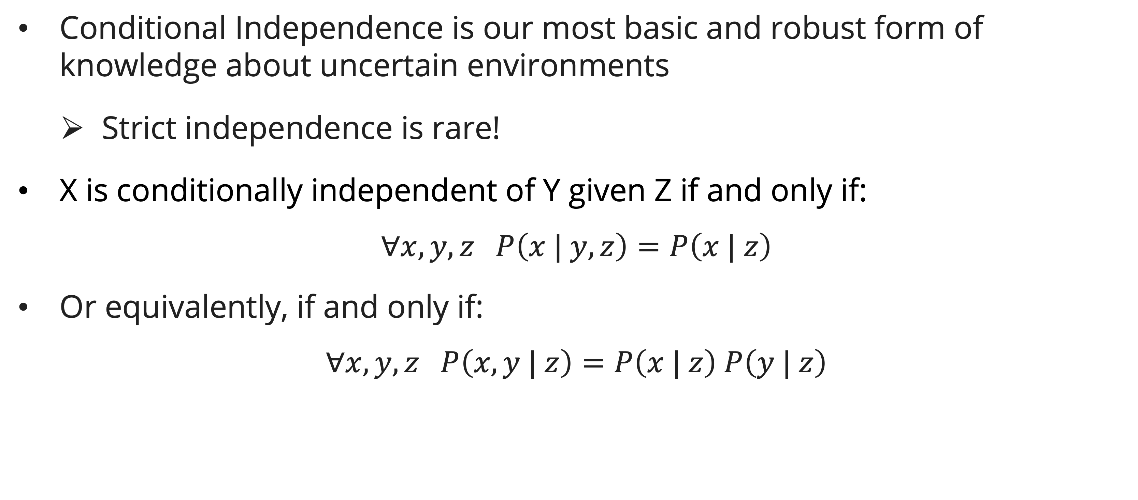
Strict and conditional independence
CONDITIONAL independence
Conditional Independence is our most basic and robust form of knowledge about uncertain environments
  Strict independence is rare!
X is conditionally independent of Y given Z if and only if:
$$∀x, y,z P\left(x | y, z\right)=P\left(x | z\right)$$
Or equivalently, if and only if:
$$∀x, y,z P\left(x,y | z\right)=P\left(x | z\right) P\left(y | z\right)$$

Slide 13
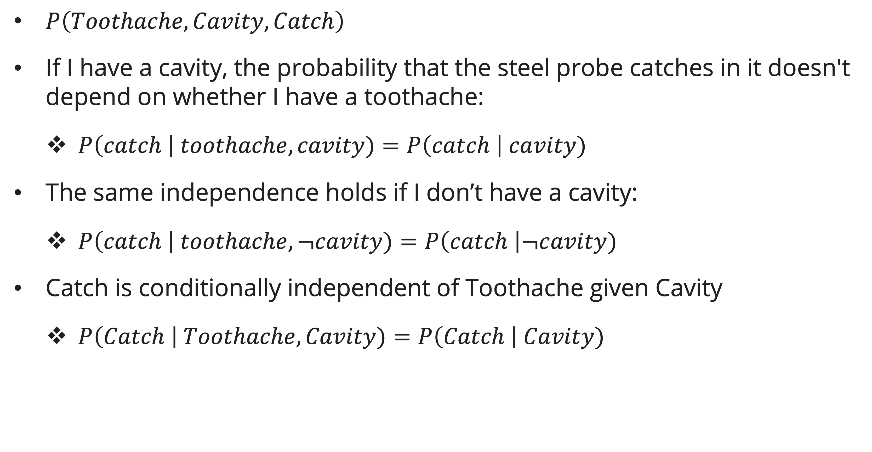
Strict and conditional independence
CONDITIONAL independence
$P\left(Toothache, Cavity, Catch\right)$
If I have a cavity, the probability that the steel probe catches in it doesn't depend on whether I have a toothache:
  $P\left(catch \right| toothache, cavity)=P\left(catch \right| cavity)$
The same independence holds if I don’t have a cavity:
  $P\left(catch \right| toothache, ¬cavity)=P\left(catch \right|¬cavity)$
Catch is conditionally independent of Toothache given Cavity
  $P\left(Catch \right| Toothache, Cavity)=P\left(Catch \right| Cavity)$

Slide 14

Strict and conditional independence
CONDITIONAL independence
$P\left(Toothache, Cavity, Catch\right)$
Equivalent statements:
  $P\left(Toothache | Cavity, Catch\right)=P\left(Toothache | Cavity\right)$
  $P\left(Toothache, Catch | Cavity\right)=P\left(Toothache | Cavity\right) P\left(Catch | Cavity\right)$
  One can be derived from the other easily

Slide 15
Bayesian network
Big picture
Using Full Joint Distributions Table as our probabilistic model has two problems:
  Unless there are only a few variables, the joint is WAY too big to represent explicitly
  Hard to learn (estimate) anything empirically about more than a few variables at a time

Slide 16
Bayesian network
Big picture
Bayesian Network: A technique for describing complex joint distributions using simple, conditional distributions
  A type of probabilistic graphical models
  We describe how variables locally interact
  Local interactions chain together to give global, indirect interactions

Slide 17
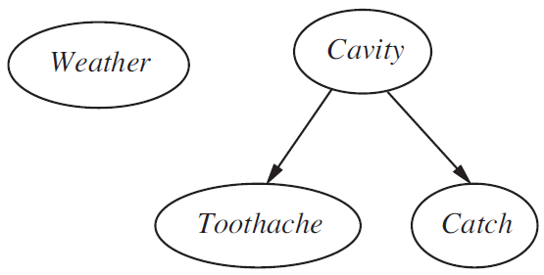

Bayesian network
Graphical model notation
Nodes: variables (with domain)
Arcs/Links: interactions
  Indicate “direct influence” between variables
  Formally: absence of arc encodes conditional independence (more later)
For now: imagine that arrows mean direct causation (in general, they don’t!)

Slide 18
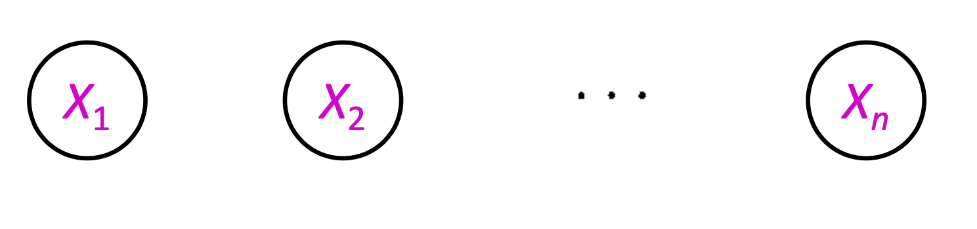
Bayesian network
Example: Coin flips
n independent coin flips
No interactions between variables: strict independence

Slide 19
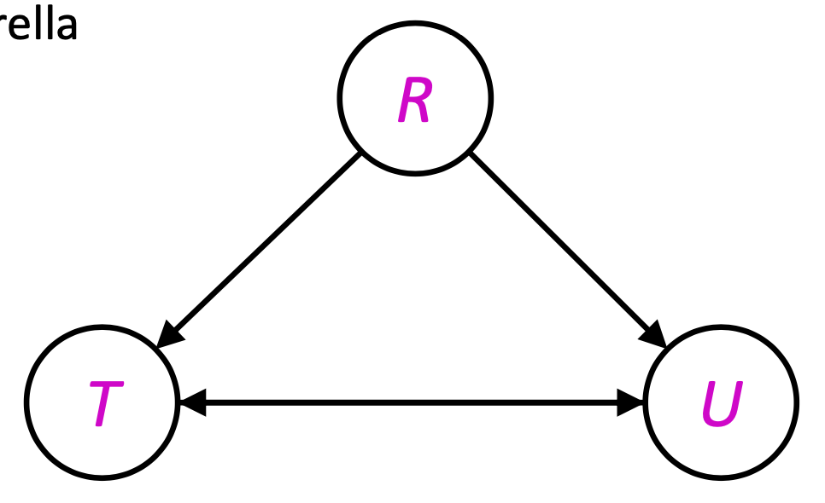
Bayesian network
Example: Traffic
Variables:
  T: There is traffic
  U: I’m bringing my umbrella
  R: It rains

Slide 20
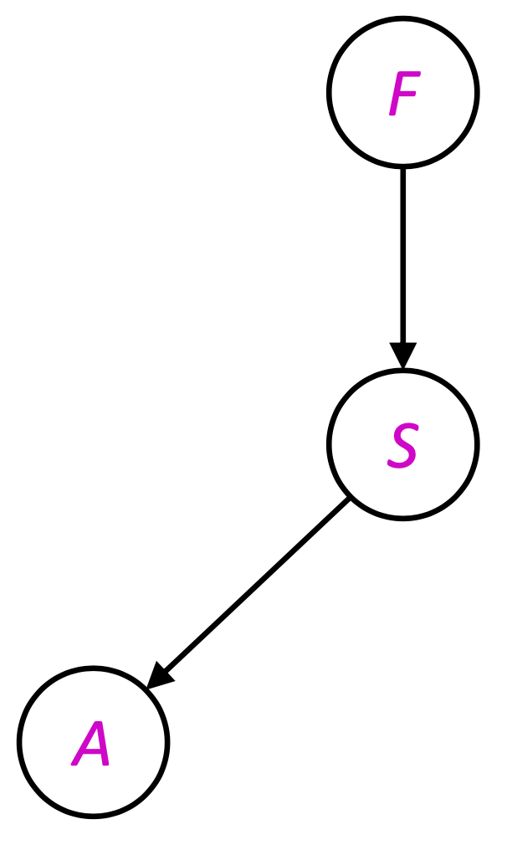
Bayesian network
Example: Smoke alarm
Variables:
  F: There is fire
  S: There is smoke
  A: Alarm sounds

Slide 21
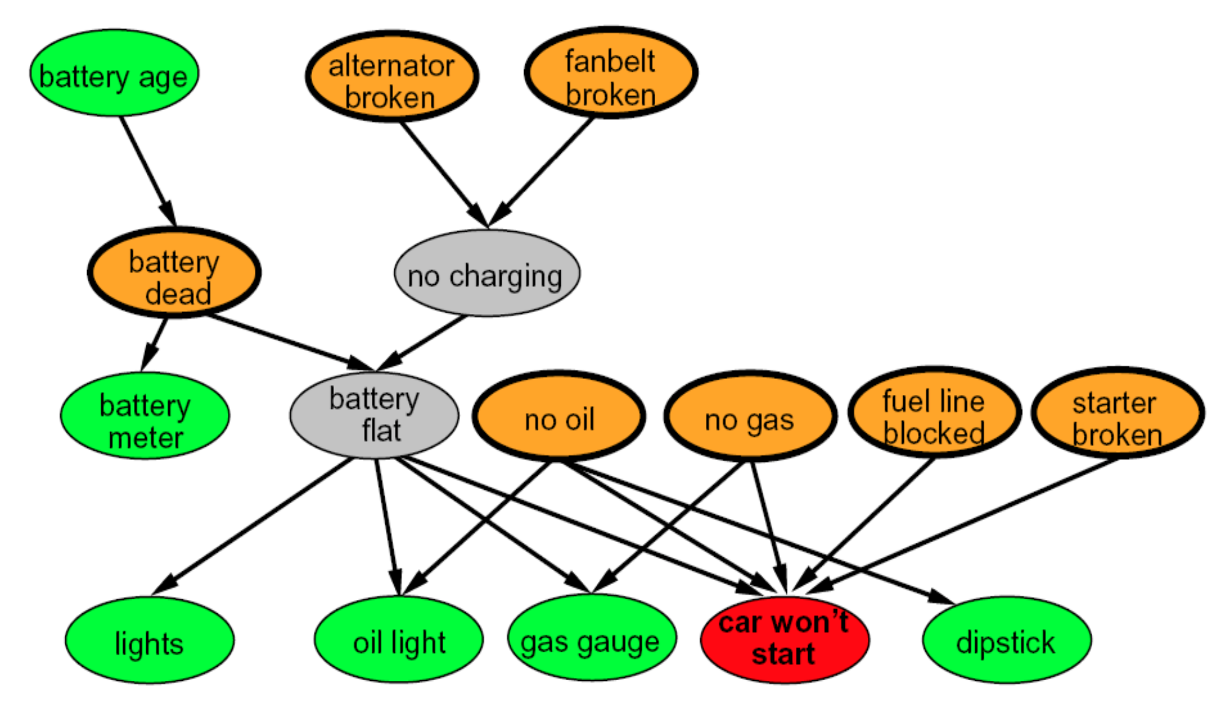
Bayesian network
Example: Car won’t start

Slide 22
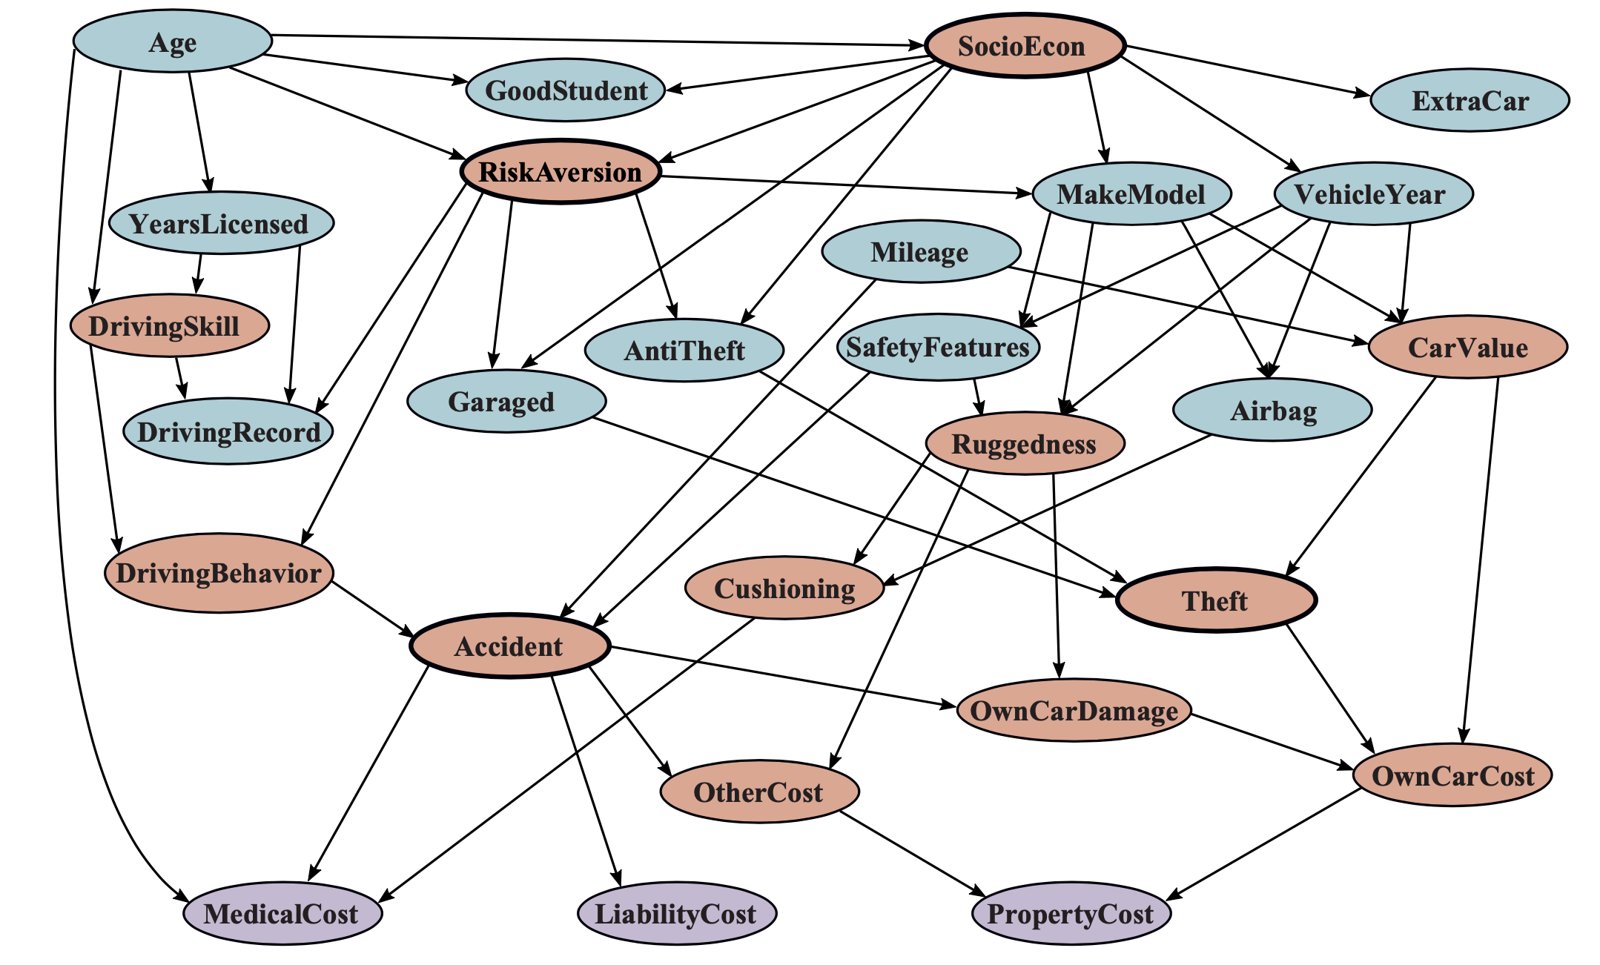
Bayesian network
Example: Car insurance

Slide 23
Bayesian network syntax and semantic
syntax
A set of nodes, one per variable Xi
A directed acyclic graph
A conditional distributions for each node given its parent variables in the graph:
  Conditional Probability Table (CPT); each row is a distribution for child given values of its parents.
Bayesian Network = Topology (graph) + Local Conditional Probabilities

Slide 24
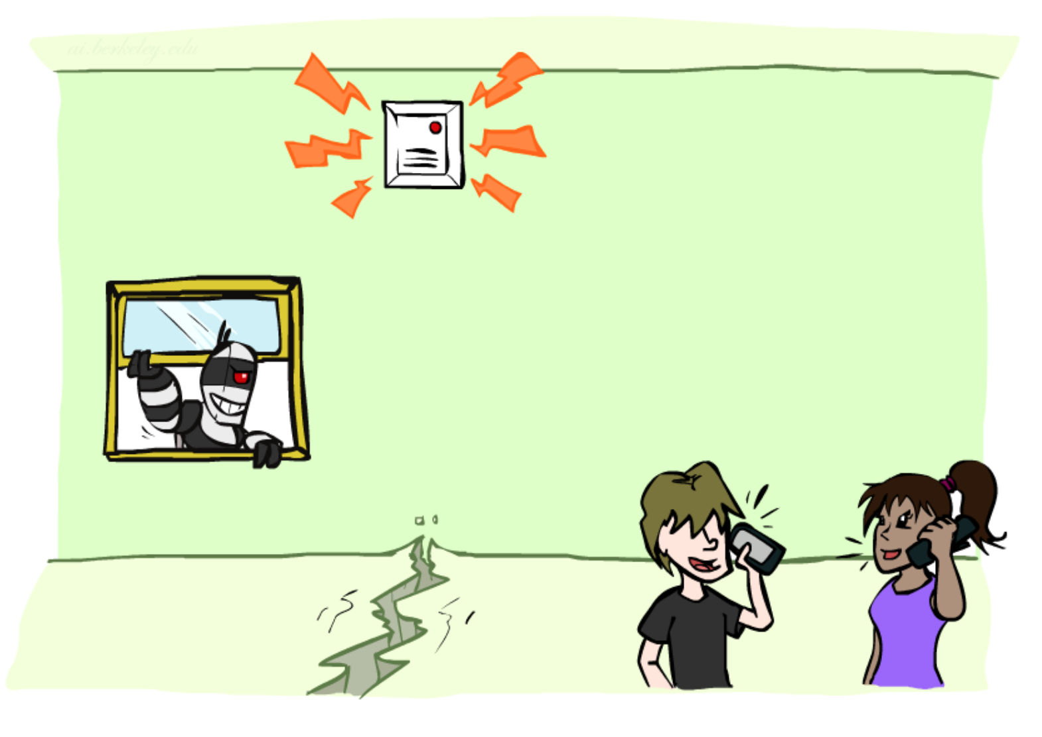
Bayesian network syntax and semantic
Example: Alarm network
Variables:
  B: Burglary
  E: Earthquake
  A: Alarm goes off
  J: John calls
  M: Mary calls

Slide 25
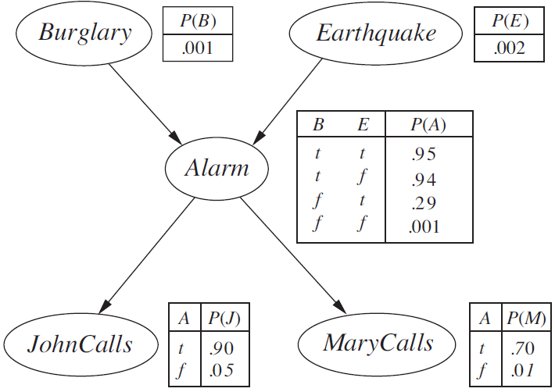
Bayesian network syntax and semantic
Example: Alarm network

Slide 26
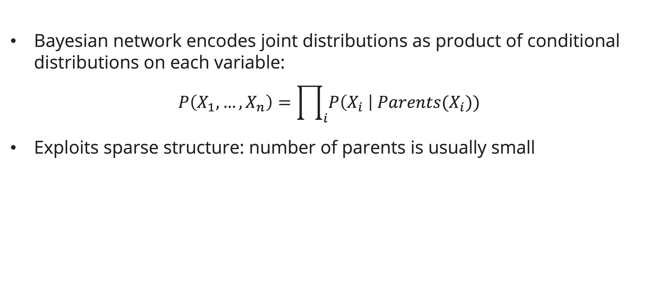
Bayesian network syntax and semantic
Bayesian network Global semantics
Bayesian network encodes joint distributions as product of conditional distributions on each variable:
$$P\left(X_{1}, …, X_{n}\right)=\prod_{i}{P\left(X_{i} \right| Parents(X_{i}))}$$
Exploits sparse structure: number of parents is usually small

Slide 27
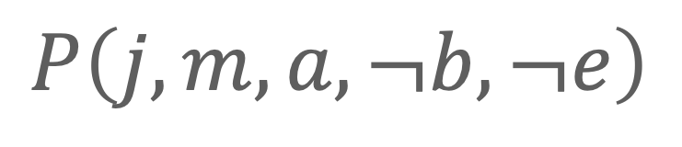
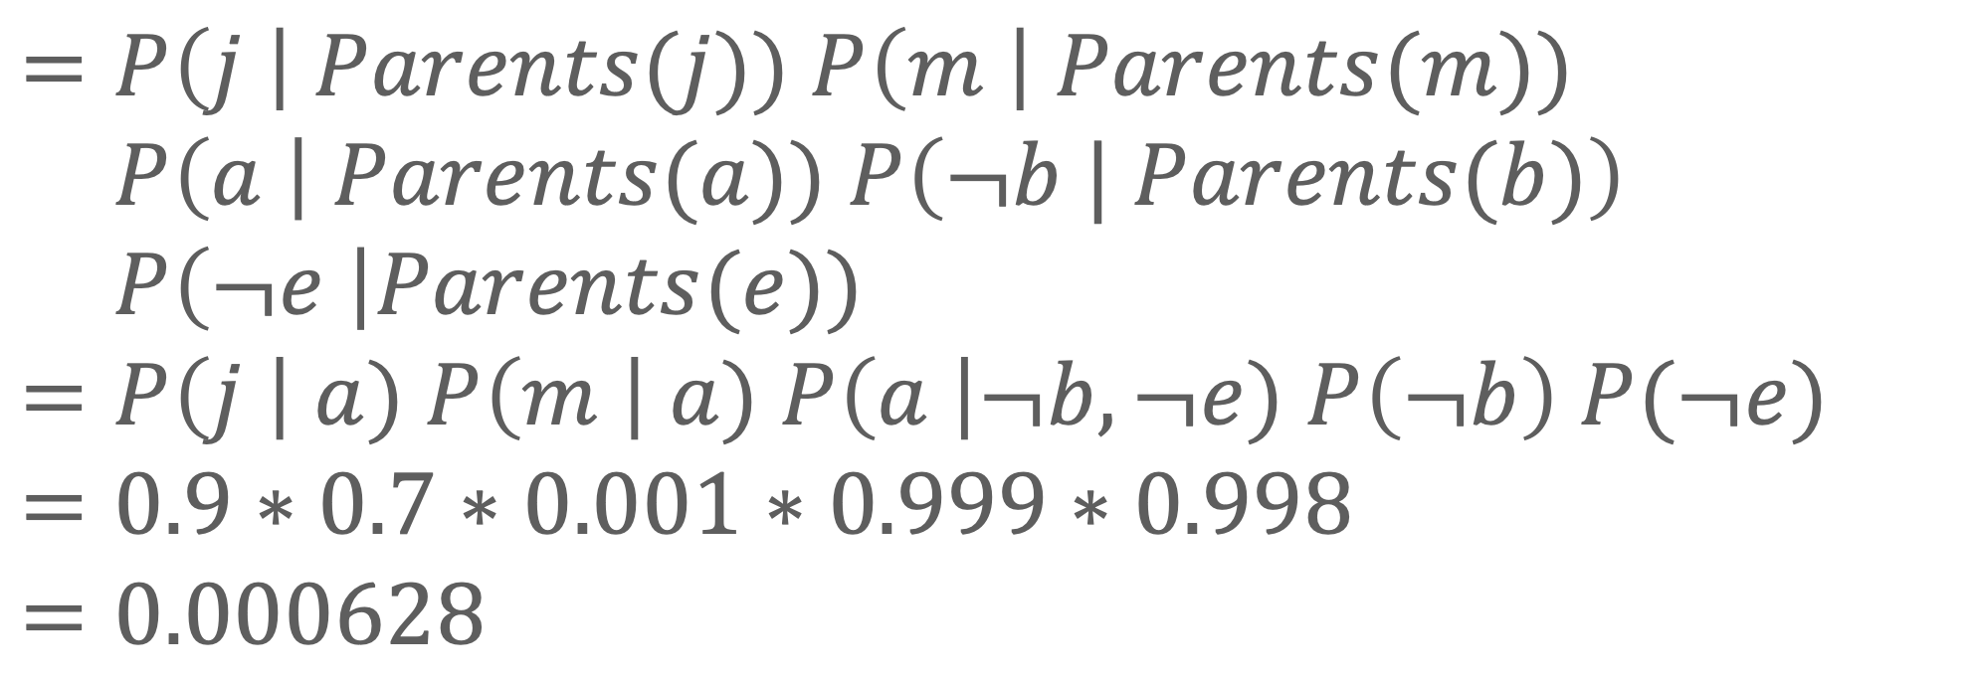
Bayesian network syntax and semantic
Example: Alarm network
What is the probability of an alarm ring but neither a burglary nor an earthquake has occurred, and both John and Mary call?
$$P\left(j, m, a, ¬b,¬e\right)$$
$$=P\left(j \right| Parents(j)) P\left(m \right| Parents(m))$$
$$=P\left(a \right| Parents(a)) P\left(¬b | Parents(b)\right)$$
$$=P\left(¬e \right|Parents(e))$$
$$=P\left(j \right| a) P\left(m \right| a) P\left(a \right|¬b,¬e) P\left(¬b\right) P(¬e)$$
$$=0.9∗0.7∗0.001∗0.999∗0.998$$
$$=0.000628$$

Slide 28
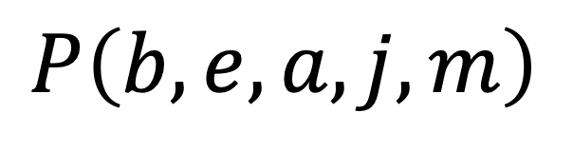
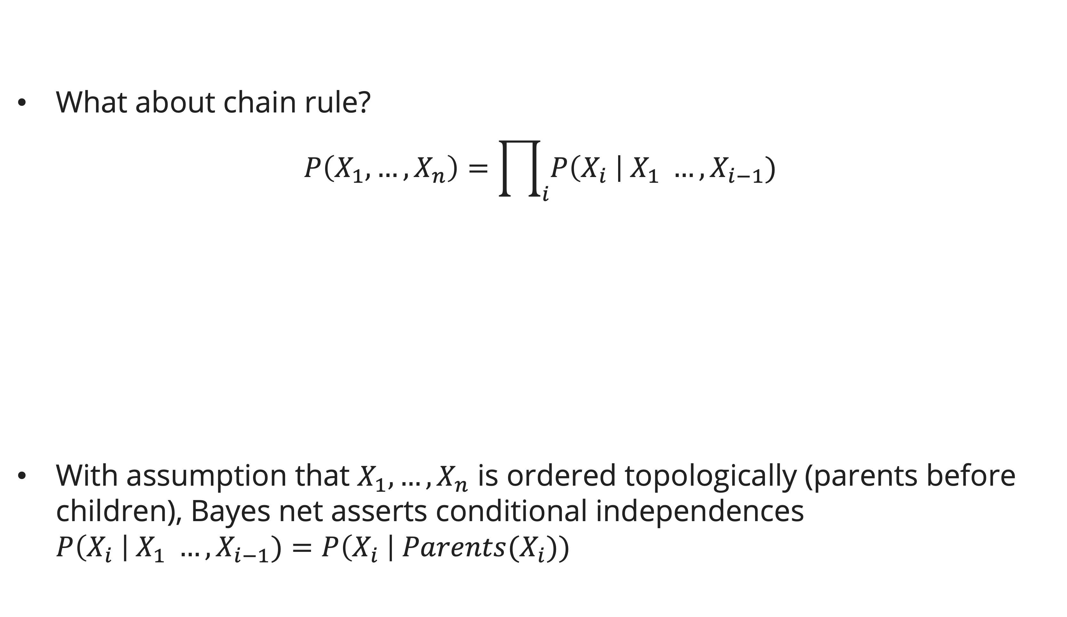
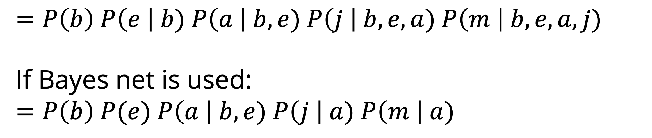
Bayesian network syntax and semantic
Example: Alarm network – Chain rule
What about chain rule?
$$P\left(X_{1}, …, X_{n}\right)=\prod_{i}{P\left(X_{i} \right| X_{1} …, X_{i−1})}$$
With assumption that $X_{1},…, X_{n}$ is ordered topologically (parents before children), Bayes net asserts conditional independences $P\left(X_{i} \right| X_{1} …, X_{i−1})=P\left(X_{i} \right| Parents(X_{i}))$
$$P\left(b, e, a, j, m\right)$$
$$=P\left(b\right) P\left(e \right| b) P\left(a \right| b, e) P\left(j \right| b, e, a) P\left(m \right| b, e, a, j)$$
If Bayes net is used:
$$=P\left(b\right) P(e) P\left(a \right| b, e) P\left(j \right| a) P\left(m \right| a)$$

Slide 29
Causality in Bayesian network
Causality
When Bayes’ nets reflect the true causal patterns:
  Often simpler (nodes have fewer parents)
  Often easier to think about
  Often easier to elicit from experts
BNs need not actually be causal
  Sometimes no causal net exists over the domain
  End up with arrows that reflect correlation, not causation

Slide 30
Causality in Bayesian network
Meaning of arrow
What do the arrows really mean?
  Topology may happen to encode causal structure
  Topology only guaranteed to encode conditional independence

Slide 31
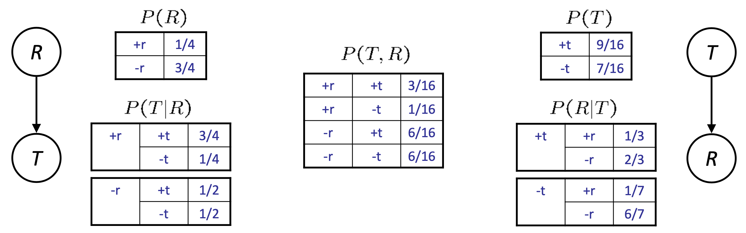
Causality in Bayesian network
Example
Traffic (left) and Reverse traffic (right) can give out the same joint distributions (middle)???
  T for Traffic, R for Rain

Slide 32
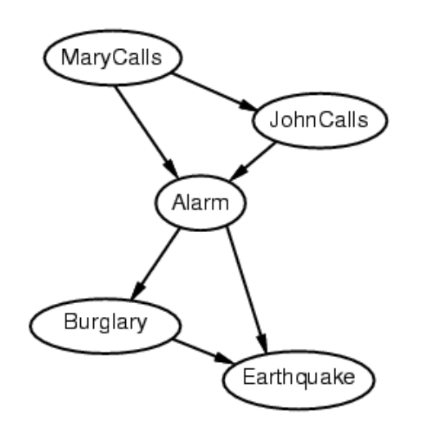
Causality in Bayesian network
Changing bayes structure
The same joint distribution can be encoded in many different Bayesian networks
  Deciding conditional independence is hard in noncausal directions (see picture)
  Causal structure tends to be the simplest
  Causal models and conditional independence seem hardwired for humans!

Slide 33
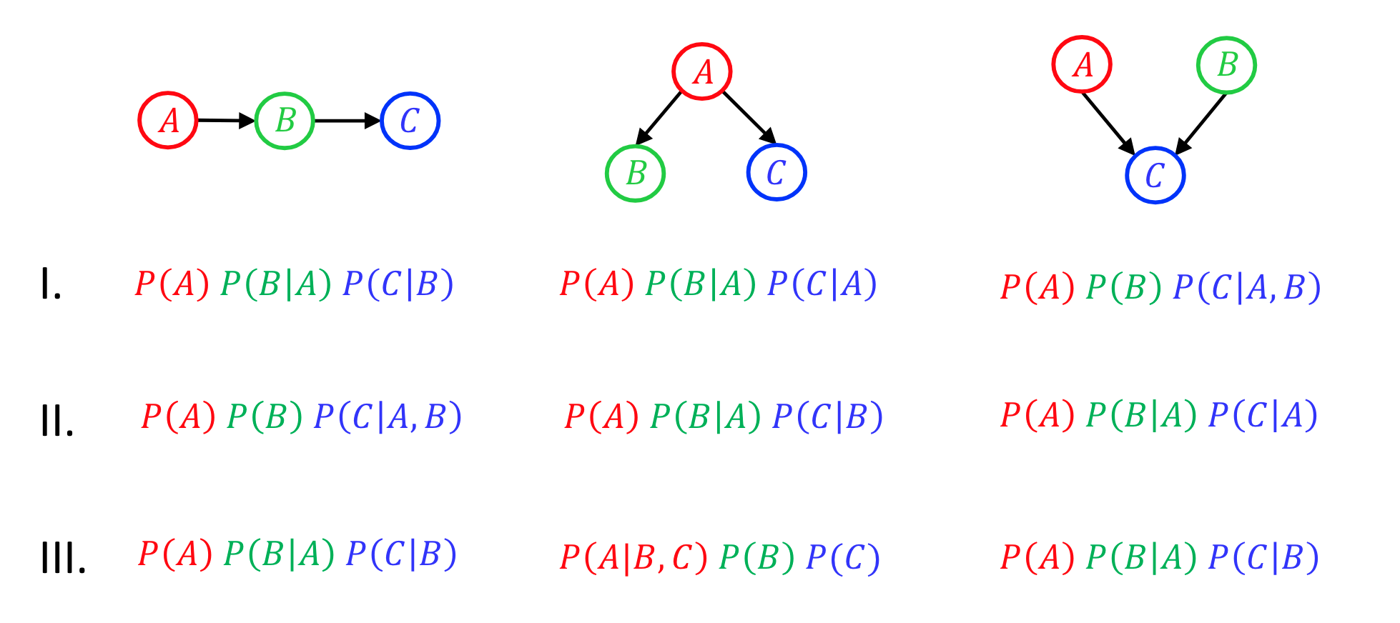
exercise
Bayesian network semantics
Match the product of CPTs to the Bayes net (Multiple choice question):
a.
b.
c.

Slide 34
exercise
Astronomer network
Two astronomers in different parts of the world make measurements M1 and M2 of the number of stars N in some small region of the sky, using their telescopes. Normally, there is a small possibility e of error by up to one star in each direction. Each telescope can also (with a much smaller probability f) be badly out of focus (events F1 and F2), in which case the scientist will undercount by three or more stars (or if N is less than 3, fail to detect any stars at all).
  There are 2 correct Bayesian networks (but not necessarily efficient) representations of the preceding information, find them and select one which is the best! Explain your answer
  Write out a conditional distribution for P(M1N), for the case where N{1,2,3} and M1{0,1,2,3,4}. Each entry in the conditional distribution should be expressed as a function of the parameters e and/or f.

Slide 35
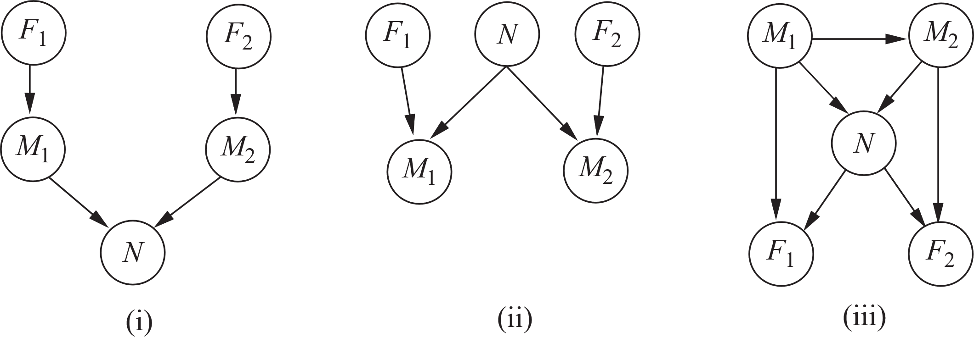
exercise
astronomer network

Slide 36
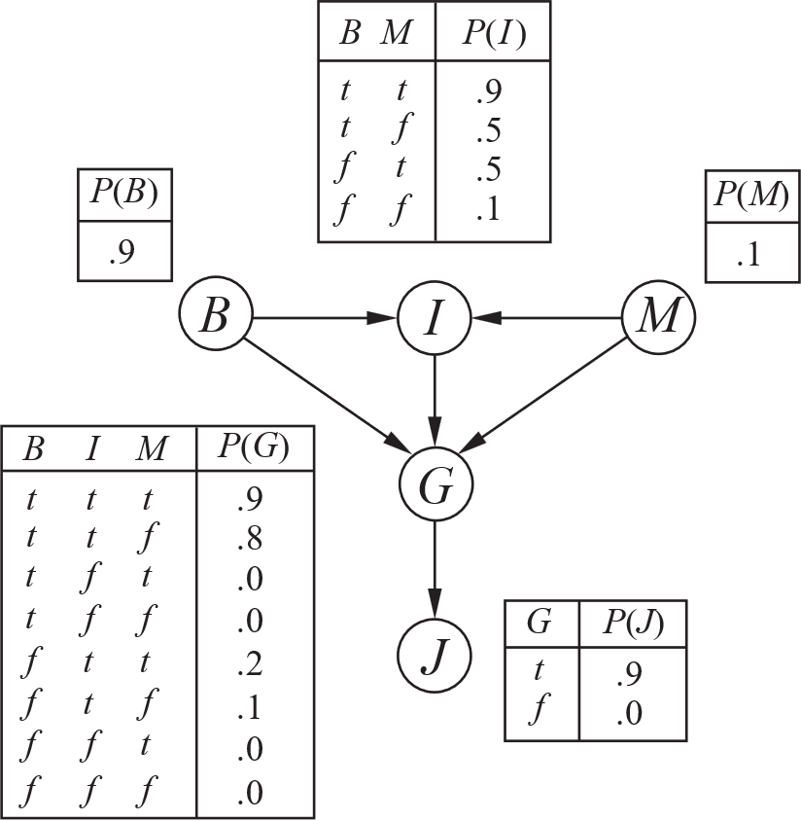
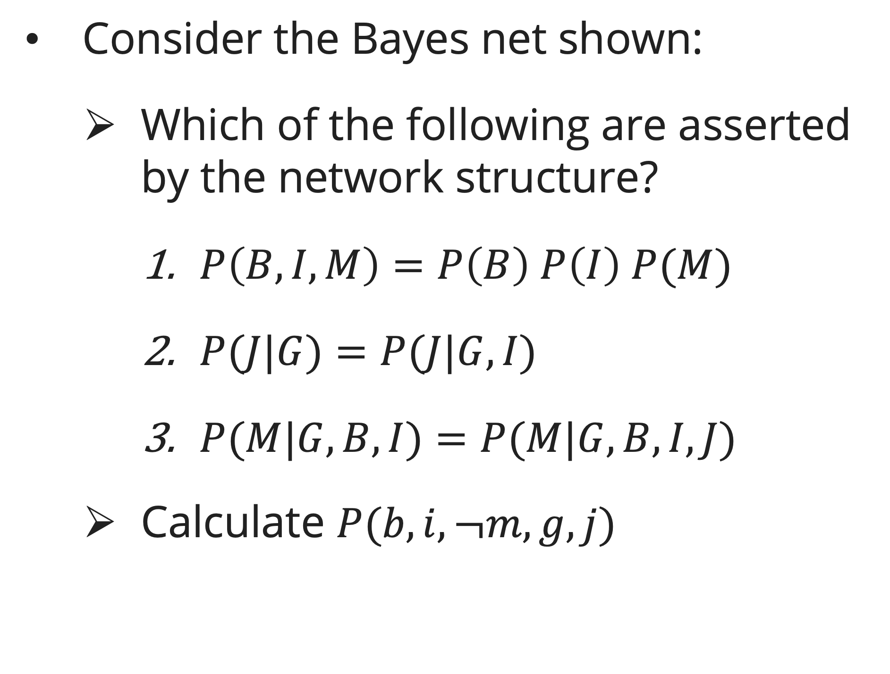
exercise
Bayesian network
Consider the Bayes net shown:
  Which of the following are asserted by the network structure?
    $P\left(B,I,M\right)=P\left(B\right) P\left(I\right) P(M)$
    $P(J|G)=P(J|G,I)$
    $P(M|G,B,I)=P(M|G,B,I,J)$
  Calculate $P(b,i,¬m,g,j)$

Slide 37
References
Session 10
Peter Norvig, Stuart Russel. (2021). Artificial Intelligence: A Modern Approach. Pearson. London. ISBN: 978-1292401133. Ch. 12-13.
Dan Klein and Pieter Abbeel. (2024). CS188 Intro to AI at UC Berkeley
Stephanie Rosenthal. (2023). CMU AI and http://ai.berkeley.edu

